Slide 1
LTE/EPC Solutions Overview
For SCTE in Oklahoma City and Tulsa, OK
July 27th & 28th, 2011
By Si Nguyen
Director, Wireless Marketing and Product Management snguyen@huawei.com

Slide 2
Contents
1
Market Drivers and Background (30 min)
2
LTE Technology Overview (75 min)
3
LTE Advanced Overview (30 min)
4
LTE Deployment Landscape (15 min)
Notes:
2

Slide 3
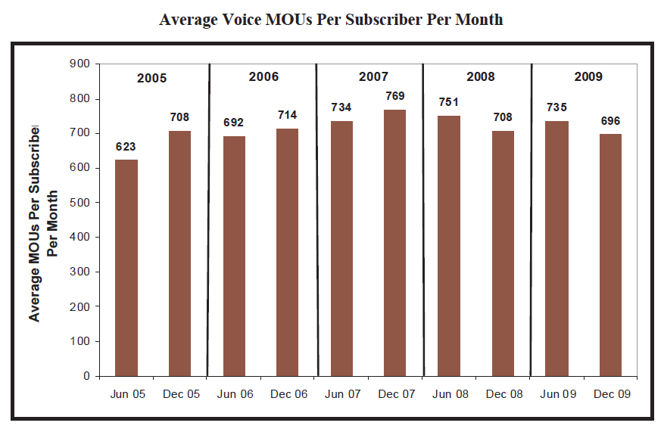
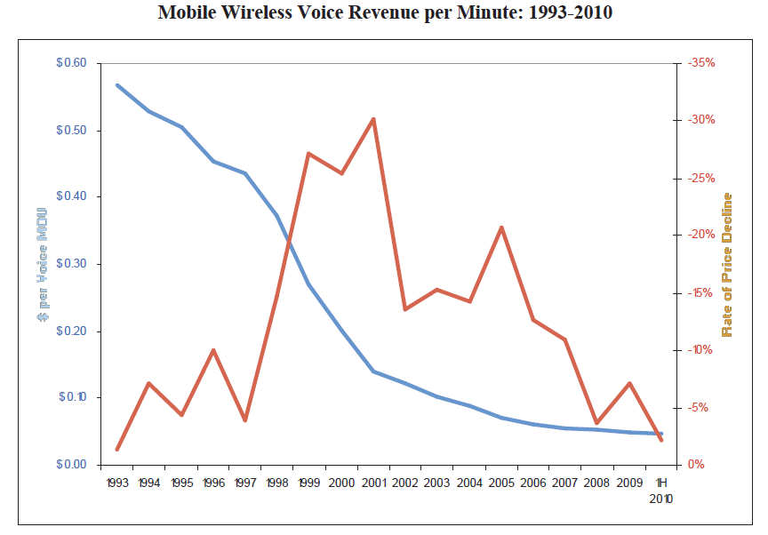
While the Voice Market has matured…
Source: FCC 2011 Mobile Wireless Competition Report
Source: FCC 2011 Mobile Wireless Competition Report
Voice usage has peaked, pricing is commoditized

Slide 4
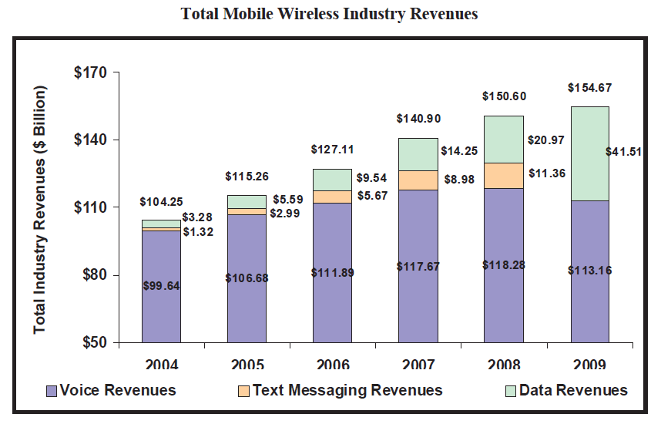
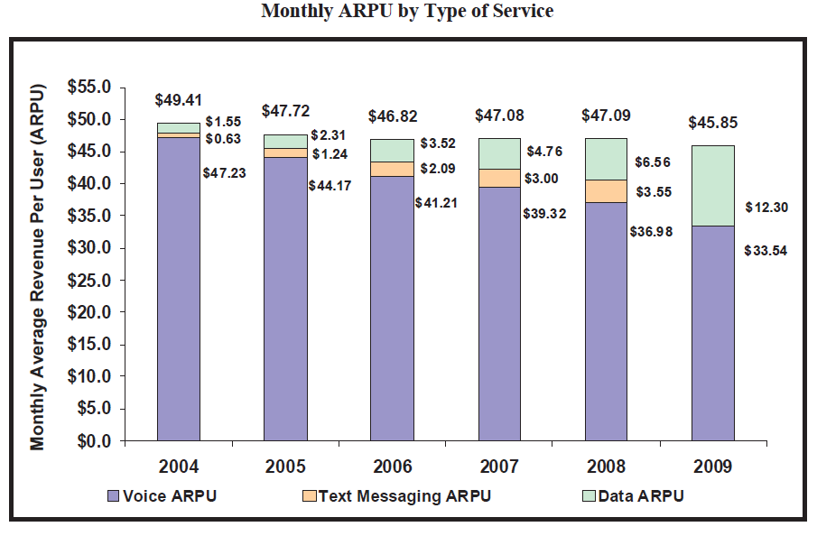
Data revenues are driving profitability
Source: FCC 2011 Mobile Wireless Competition Report
Source: FCC 2011 Mobile Wireless Competition Report
Voice market revenue peaked, data revenue is growing, total ARPU is declining

Slide 5
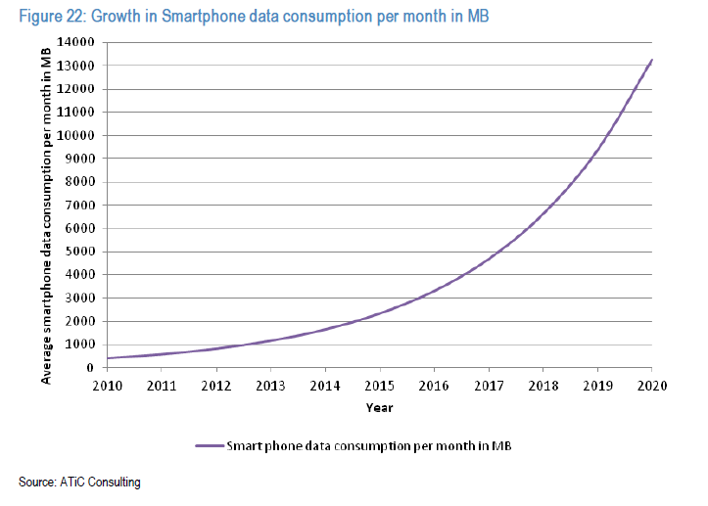
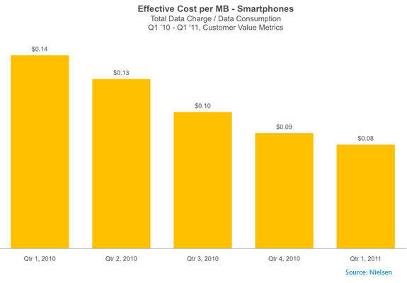
Data Consumption continues to surge but so will Price Erosion
43% YoY
Price per MB
erosion

Slide 6

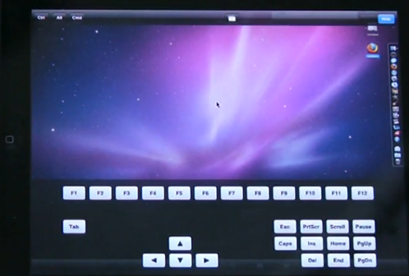
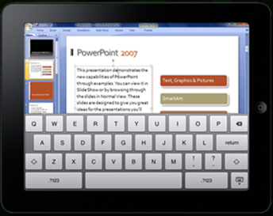

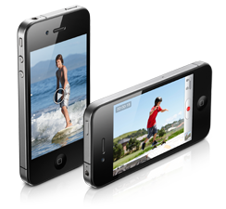

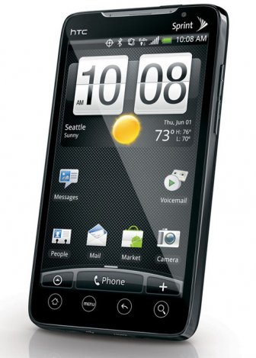

Terminals Continue to Shape Behaviors
2000
0.02x traffic
2010
1x traffic
~500 millions Smart Phones
2020
~ 1000x traffic
4 billions new Smart Phones
10 billions new Smart Devices
Millions of new Apps
Cloud based Services
Talking while Moving Viewing while Sitting

Slide 7

Mobile Data is the Key Revenue Engine…
Data revenue will surpass voice revenue
Mobile data drives total revenue growth
Stable mobile data revenue growth
Revenues
(US$ million)
Stable mobile revenue growth
Source: Huawei 2010
Source: Informa 2010

Slide 8
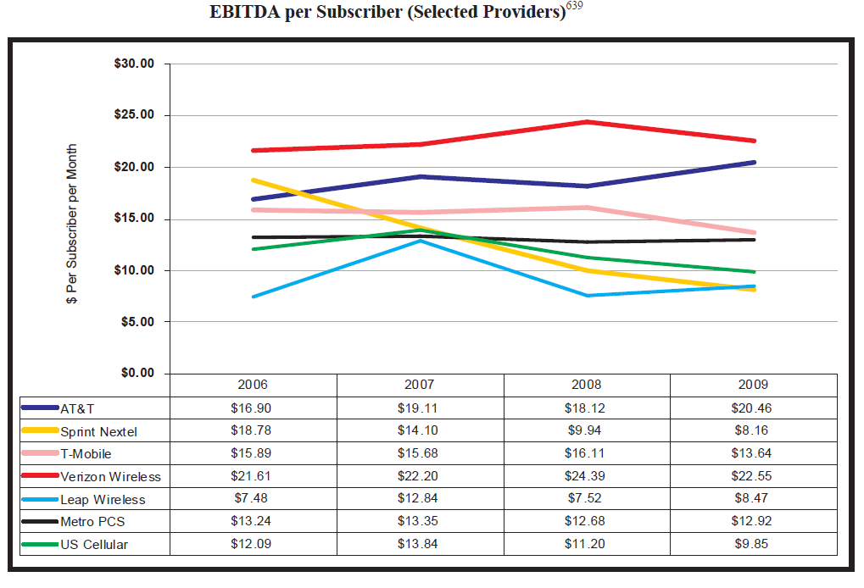
Profitability remains a challenge for most operators…
Source: FCC 2011 Mobile Wireless Competition Report

Slide 9






Tremendous Increase in Mobile Traffic
…But declining profitability of MBB becomes the major obstacle
5 Billion
LTE broadband subscriptions will grow rapidly from 2012 onwards
About 40 million LTE subscriber by 2013
LTE to reach 100 Million Subscriptions Faster Than Any Previous Mobile Standard - Pyramid Research
5 GB/month
500 Million
MBB Subs
0.1GB/month
2010
2020
2010
2020
Voice & SMS
Mobile broadband
Ultra Broadband
B
?
A
Moderate
performance
C
Golden age
Voice
SMS
WAP
Mobile video
Value per bit
Mobile internet
MBB access
Millions of applications
Killer application domain
Long tail operation

Slide 10









3GPP LTE Vision and Design Targets
Ultra-high
data rate and
low latency
Enhancing User
Experience
LTE
Ubiquity:
Quad Play
Low cost
LTE Wish List
Scalable system bandwidth from 1.4MHz to 20MHz (paired or unpaired)
Significantly increased peak data rate (e.g. 100/50Mbps for DL/UL)
Significantly improved spectrum efficiency (capacity) ~1.6 bits per sec per Hz (e.g. 2-4x HSPA and EV-DO revA)
Increase cell-edge bitrate (e.g. 2-3x HSPA and EV-DO revA)
Reduce the latency (eg.100ms from idle to active, 10ms for eRAN RTT)
Further enhanced MBMS (eg. 1~3Mbps)
Support high speed mobility (eg.350Km/h)
Simplify system and terminal design
Notes:
10

Slide 11
Contents
1
Market Drivers and Background (30 min)
2
LTE Technology Overview (75 min)
3
LTE Advanced Overview (30 min)
4
LTE Deployment Landscape (15 min)
Notes:
11

Slide 12






General 3GPP Network Architecture
-- Evolve to flat network architecture
LTE Highlights:
Only Data, No CS
No RNC/BSC
ENodeB interconnected
Differentiated UP and CP
BSS
BSC
MSC
BTS
Abis
2G
GPRS/EDGE
Gb
RNC
Circuit Switched
Iub
Iu-PS-U
3G
NodeB
Iu-PS-C
Packet Switched
UMTS/HSDPA
Iur
+ MME
SGSN
HSS
S6
S1-MME
Gn / S11
S1-U
Gi / SGi
LTE
LTE
+ SGW+PGW
GGSN
eNodeB
Access Network
Core Network

Slide 13




LTE/EPC Flat IP Network
E-RAN
Evolved
Packet Core
HSS
eNodeB
Control plane
User plane
S6a (Diameter)
MME – Mobility Management Entity
Serving GW – Serving Gateway
PDN GW – Packet Data Network Gateway
HSS – Home Subscriber System
PCRF – Policy and Charging Rule Function
PCRF
LTE
S1-MME (S1-AP)
S10
S9
X2
MME
S1-U
S11
Gxc
Gx
Operator Service Network
S1-MME
LTE
Internet
S1-U (GTP)
S5/S8
(GTP or PMIPv6)
SGi
eNodeB
Serving GW
PDN GW
Corporate Services
E-NodeB Becomes “smarter”
RRM
Scheduler
LTE specific features
HO & IRAT HO
SON support and implementation
ALL-IP flat network architecture
Flexible deployment options for centralized services and local breakout for internet access
Scalable architecture for capacity growth

Slide 14
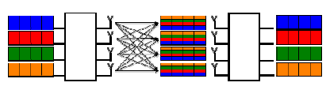

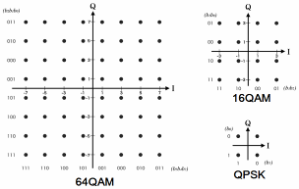
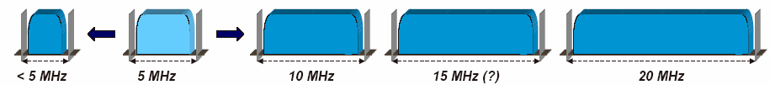
Key Technologies adopted in LTE Physical Layer
DL
OFDMA
173M
RB=12x15khz
Data
Streaming
MIMO
Channel
UL
SC-FDMA
84M
MIMO (Multiple input Multiple Output) for UL & DL
Increased link capacity
Multi-Users MIMO (UL)
Overcome multi-path interference
OFDMA / DL
SC-FDMA / UL
MIMO
LTE
64QAM
HOM
Scalable
Bandwidth
Scalable Bandwidth
BW | 1.4Mhz | 3 Mhz | 5 Mhz | 10 Mhz | 15 Mhz | 20 Mhz
RB | 6 | 15 | 25 | 50 | 75 | 100
#SC | 72 | 180 | 300 | 600 | 900 | 1200
Higher Modulation Technology increase bandwidth

Slide 15
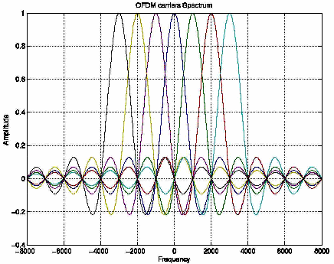
OFDM Theory
OFDM Sub-Carriers
Frequency
Serial data stream mapped onto many parallel sub-carriers
  Lower symbol rate and longer symbols vs. single-carrier
Subcarrier spacing < coherence bandwidth of channel
  Channel frequency response is flat over a subcarrier, so channel equalization is not needed
The sub-carriers are orthogonal
  At each sub-carrier center, neighboring sub-carriers ideally have zero amplitude
  This removes need for inter-sub-carrier guard bands
OFDM leverages the Discrete Fourier Transform (DFT) to synthesize and recover the signal
  Fast Fourier Transformation (FFT/IFFT) algorithm reduces computational complexity

Slide 16
Wireless Technology PHY Comparison
Standard / Technology | Symbol Period | Channel or Subcarrier Spacing
EV-DO / CDMA | 0.78 μs (1/1.288Mcps) | 1.25 MHz
UMTS / CDMA | 0.26 μs (1/3.84Mcps) | 5 MHz
LTE / OFDMA | 66.7 μs | 15 kHz
Symbol period is roughly 1/(channel spacing) for single-carrier systems, 1/(subcarrier spacing) for OFDM
OFDM: Long OFDM symbol periods mitigate Multipath without equalization
CDMA: Short symbol periods relative to delay spread requires channel equalization (i.e. rake receiver) to mitigate ISI
  Rake receiver adds cost/complexity

Slide 17
OFDM Cyclic Prefix (CP)
T – FFT interval
T_{CP} – cyclic prefix guard period
T + T_{CP} – OFDM symbol period
τ_{max} – max multi-path delay
T_{CP}
T
Multi-path arrivals
τ_{max}
T
ISI-free symbol start region
CP adds overhead but provides inter-symbol interference (ISI) mitigation
LTE defines normal CP of 4.7μs and extended CP of 16.7μs

Slide 18
OFDM Tx/Rx Structure
.
.
Transmitter
Serial to Parallel
.
.
IFFT
Parallel to Serial
.
.
Add Cyclic Prefix
.
.
s[n]
s(t)
bit-stream in
…
…
…
OFDM signal out
.
.
.
.
Constellation Mapping
.
.
Receiver
Parallel to Serial
.
.
FFT
Serial to Parallel
.
.
Remove Cyclic Prefix
.
.
s[n]
s(t)
bit-stream out
…
…
…
OFDM signal in
.
.
.
.
Symbol Detection

Slide 19
OFDM Advantages
Low-complexity UE receiver design
  Efficient IFFT/FFT processing
  Traditional equalizer not needed
Robust fading channel performance
  Long symbol time with cyclic prefix provides tolerance to multi-path delay spread without equalization
Each sub-carrier modulated independently
  Allows MCS adjustment across frequency to match channel conditions
Improved MIMO performance due to flat frequency response per subcarrier

Slide 20
OFDM Limitations
Peak Power Problem
  The OFDM signal has a large peak to average power ratio (PAPR)
  Higher power amplifiers are needed leading to increased cost and linearization requirements and decreased power efficiency
  Low noise receiver amplifiers need larger dynamic range
Inter-Carrier-Interference (ICI)
  Due to narrow subcarrier spacing, frequency offsets, phase noise, and Doppler spread degrade orthogonality and create ICI
  OFDM design parameters trade off robustness to fading (delay spread) and Doppler (velocity)
Capacity and Power Loss Due to Cyclic Prefix
  Cyclic prefix consumes bandwidth and transmit power

Slide 21
Downlink based on OFDMA
Sub-frames
Groups of subcarriers
Users are multiplexed onto time and frequency OFDM resources
Frequency-diverse scheduling helps maximize spectral efficiency from a system perspective

Slide 22
SC-FDMA
DFT
Additional step
Single Carrier Frequency Division Multiple Access (SC-FDMA) is a form of DFT Spread-OFDM with adjacent subcarrier mapping
  An additional DFT spreads information across all subcarriers
  Contiguous subcarrier allocation for IFFT results in single-carrier signal
Advantage: The single-carrier signal has generally lower peak-to-average power ratio (PAPR) which allows use of lower cost UE power amplifier (PA) and reduces UE power consumption
Disadvantage: Single-carrier modulation results in ISI and requires equalization

Slide 23
Uplink based on SC-FDMA
Sub-frames
SC-FDMA is used for uplink in LTE
As with OFDMA DL,
  Users are multiplexed onto time and frequency OFDM resources
  Frequency-diverse scheduling helps maximize spectral efficiency from a system perspective

Slide 24

Frequency Selective Scheduling
Different users experience different fading in time-frequency domain
OFDMA and SC-FDMA in LTE support flexible DL/UL scheduling to achieve frequency-selective scheduling gain
User 1
SINR
User 2
Optimal allocation
Time
Frequency
Benefits: Increased radio link reliability, cell capacity and coverage

Slide 25
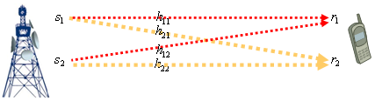
MIMO
MIMO adds spatial dimension to the wireless PHY interface
Beamforming (BF) and Transmit Diversity (TD)
  Mainly for improving coverage through the parallel transmission of differently weighted (BF) or coded (TD) versions of a single stream
Spatial Multiplexing (SM)
  Improves capacity through the parallel transmission of multiple spatial streams on the same time-frequency resources

Slide 26
MIMO Modes (1)
Beamforming or Transmit Diversity
  1 stream/resource
  High gain for low SNR
  Capacity enhancement & coverage extension
  BF increases SINR due to increased received power
  SFBC increases SINR via diversity gain
Spatial Multiplexing
  Multiple streams/resource
  High gain for high SNR
  Capacity enhancement
Shannon Channel Capacity Theorem
Power-Limited
Bandwidth-Limited

Slide 27
MIMO Modes (2)
Open loop MIMO
  No feedback about channel state information from receiver
  Cannot be optimized for specific user’s channel condition
  Robust for channel variation (e.g. high speed)
Closed loop MIMO
  Utilizes channel state information feedback from receiver
  Can be optimized for specific user’s channel condition
  Vulnerable for channel variation

Slide 28
MIMO Modes (3)
Single-user MIMO
  One user has multiple streams
  Good performance for small number of users
Multi-user MIMO (SDMA)
  Multiple users share resources
  Good performance in case there are lots of users in a cell
  More accurate channel feedback is required
  Orthogonal spatial channels between users are needed

Slide 29

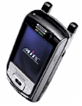
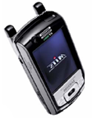

DL MIMO in LTE
Rank = 1
SFBC
Pre-coder
codeword
Mod
codeword
Mod
Transmit Diversity via Space Frequency Block Coding (SFBC)
Beamforming
(codebook or non-codebook-based)
Rank > 1
LTE eNB has up to 4 Tx chains
LTE UE has up to 4 Rx chains
(2) UEs determine best precoding matrix
(1) Reference symbols
SU
UE
Layer 1, CW1
Layer 1, CW1
Pre-coder
codeword
Mod
codeword
Mod
UE
codeword
Mod
codeword
Mod
Layer 2, CW2
MU
Layer 2, CW2
UE
UE Feedback
(3) Precoding matrix indication (PMI),
rank indication (RI)
Open-Loop Spatial Multiplexing
Closed-Loop Spatial Multiplexing (Single or Multi-User)

Slide 30

UL MIMO in LTE
1x2 SIMO MRC Rx Diversity
1x2 MU MIMO (with UE pairing)
Single-Layer transmission at UE
  Optional switched Tx-Diversity
Maximum ratio combining (MRC) at eNB increases uplink range/sensitivity
“Virtual” MIMO on UL with single-transmitter UEs
UEs with orthogonal channels are paired
Allows resource reuse in highly-loaded scenarios
Degrades single-user performance due to interference

Slide 31
Adaptive MIMO in LTE
MIMO has multiple modes and configurations:
  Transmit Diversity vs. Spatial Multiplexing
  Closed-Loop vs. Open-Loop
UE feedback to eNB:
  Channel Quality Indication (CQI) indicates DL SINR
  Rank Indication (RI) indicates number of layers DL channel can support
  Precoding Matrix Indication (PMI) indicates DL channel state and best precoding matrix for use in CL-MIMO
Adaptive MIMO maximizes performance based on CQI, RI, PMI, UE speed, and other factors
CL for lower speeds since channel state information (conveyed in PMI) is timely
OL at higher speeds
Rank-1 BF or TD for low SINR
SM (OL or CL) at higher SINR and rank
Speed/CL BF Gain
TD
OL SM
CL Rank-1 BF
CL SM
Channel Quality / Rank

Slide 32
LTE OFDM Parameters
Parameter | Theory | LTE
Useful Symbol Time |  | 66.7 μs
Cyclic Prefix Time |  | 4.7 or 16.7 μs
Total Symbol Time |  | 71.4 or 83.4 μs
Subcarrier Spacing |  | 15 kHz (k=1)
Number of Subcarriers |  | 72-1200
Total Bandwidth |  | 1.4, 3, 5, 10, 15, 20 MHz
1
. . .
2
3
frequency
. . .
. . .
N
time

Slide 33
Frame Structure
1 ms
LTE transmission time interval (TTI) is one subframe (1 ms)
  2 slots
  14 symbols (for normal CP)

Slide 34
Resource Grid and Resource Block
(RB)
frequency
1 RB equals 12 subcarriers in frequency and 1 slot in time
time

Slide 35
LTE Numerology
Transmission BW (MHz) | 1.4 | 3 | 5 | 10 | 15 | 20
Number of Resource Blocks | 6 | 15 | 25 | 50 | 75 | 100
Number of Subcarriers | 72 | 180 | 300 | 600 | 900 | 1200
FFT Size | 128 | 256 | 512 | 1024 | 1536 | 2048

Slide 36



Key LTE Upper Layer Technologies
Transient period
Talk spurts
Silent period
Talk spurts
2
Power
Cell
1
7
2
3
Frequency
SID frame
7
1
3
6
1
4
Power
Cell
2,4,6
6
5
4
Frequency
20ms
160ms
Dynamic
Semi-Persistent
5
Power
Cell
3,5,7
1ms TTI
HARQ/ARQ
AMC
PWR CTRL
ICIC
Frequency
Performance
Scheduling
LTE
ANR: Automatic Neighbor Relation
SON
Mobility
Network Control HO
IRAT Mobility
Self-Config.: Quick Deployment
File Server
S/W
LTE Coverage
Config
M2000, DHCP
Cell Reselection
PS Hand over
Config
2G/3G Coverage
S/W
eNodeB
Notes:
36

Slide 37
Inter-Cell Interference Coordination (ICIC)
Power
Cell
1
2
2
7
3
Frequency
7
3
1
Power
1
Cell
2,4,6
6
4
6
4
Frequency
5
5
Power
Cell
3,5,7
Frequency
Description:
SFR based interference coordination scheme supported.
X2 interface facilitated the information exchanging between eNB to do dynamic interference coordination.
Benefits:
30-50% higher throughput for cell edge users (<50% load).
Provide a better service experience for cell edge users.

Slide 38


Semi-persistent scheduling
Principle
Benefit
Semi-persistent scheduling during talk spurt, dynamic scheduling during silence period, persistent resource is released at talk to silence transition
Allocate semi-persistent resource for VoIP with period 20ms.
Ensure the voice quality
Save the overhead of PDCCH and increase the VoIP capacity.

Slide 39
LTE Handover Scenarios
Intra-frequency Handover
EUTRAN Freq. 1
Inter-RAT Handover
Inter-frequency
Handover
EUTRAN Freq. 2
Other RATs: UTRAN / GERAN / CDMA 2000

Slide 40
Scope of SON: Self-x Functionality
Self-planning
Self-configuration
Derivation of initial network parameters
Minimize radio network planning
Automized eNB configuration planning
Auto-discovery of environments
eNB automatic discovery
Plug & Play installation
Automatic SW download
Automatic SW upgrade
Automatic Configuration file download
Self-test & report
Deployment
Operation
Maintenance
Planning
Self-maintenance
Self-optimization
Automatic problems detection
Automatic problem mitigation/solving
Real time performance management
Automatic inventory management
Self-test
Parameter optimization with commercial terminal assistance
Reduce driver test
Improve network quality and performance

Slide 41






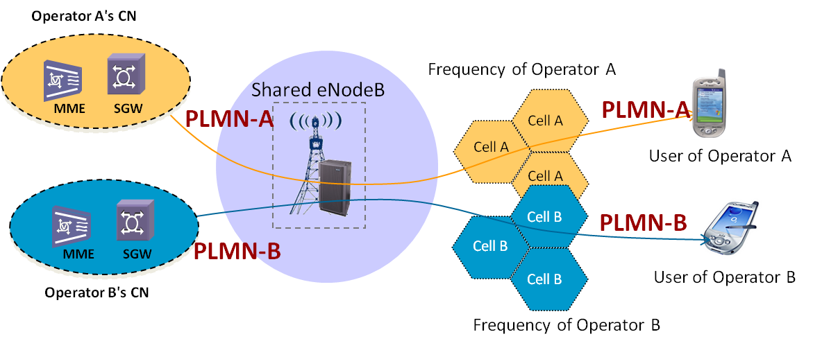



Key Network Technologies
MME selection
MME Pool
Operator’s
IP Service
SGW selection
PDN-GW selection
(EPS Bearer)
SGW Pool
PDN-GW Pool
dynamic policy charging control
Per service flow QoS
E2E QoS
Pool Resources
Hardware Pooling for Scalability and network reliability
EPS
Shared eRAN Network
Independent Core Network
A common core for all wireless technology
RAN Sharing
Common Core
SGSN
EMS (M2000)
HSS/SPR
Control plane
GPRS
Gb
User plane
BTS
BSC/PCU
Iu
S3
S4
S6a
PCRF
Sp
UMTS
S10
Evolved Packet Core
S9
NodeB
RNC
MME
Gxc
Gxa
Gx
S1-MME
S12
S11
Operator Service Network
S5/S8
Internet
LTE
S1-U
Serving GW
SGi
Corporate Services
eNodeB
S101
S103
PDN GW
CDMA
A10/A11’
S2a
BTS
BSC/PCF
PDSN/HSGW
Notes:
41

Slide 42



Interworking with Legacy 3GPP PS by S3/S4
Generally, these two logic functions are combined into one physical node.
BTS
BSC/PCU
GSM BSS
SGSN
S3
S4
NodeB
RNC
SGi
Internet
UMTS RAN
Legacy PS
S11
SAE/LTE
MME
S-GW
P-GW
S1-MME
eNodeB
S1-U
E-UTRAN
The EPC core interconnect with legacy 2G/3G PS core by S3/S4 interface. In this solution, the existing SGSN should be upgraded to become S4 SGSN and the existing GGSN should be upgraded to become SAE GW. The serving gateway becomes the common anchoring point between LTE and 2G/3G. In this case, the legacy PS core can enjoy some enhancement of R8, such as the label QoS profile, the idle signaling reduction etc.

Slide 43
LTE to eHRPD PS HO with eHRPD support - Optimized Handover
This solution introduces S101 and S103 interfaces.
The S101 reference point is used to convey pre-registration and handoff signalling between EPS and EVDO.
The S103 reference point is a user plane interface used to forward DL data to minimize packet losses in mobility from eUTRAN to EVDO. The S103 reference point supports the ability to tunnel traffic on a per-UE, per-PDN basis.

Slide 44
RAN Sharing - Multiple Core Network Sharing Common RAN with Dedicated Carriers
Total of 5 network sharing scenarios outlined in 3GPP
eNB sharing including antenna, sites, etc. No impact to core networks.
Main characteristics：
  Common E-UTRAN connecting multiple cores owned by different operators
  Each operator uses its own spectrum
PLMN1 – Spectrum 1
Carrier 1 Core
PLMN2 – Spectrum 2
Carrier 2 Core
E-UTRAN

Slide 45
RAN Sharing with Shared Spectrum
Two solutions: MOCN & GWCN. MOCN limited to radio network sharing only (eNodeB)，GWCN shares radio and core networks (eNodeB & MME).
Core 1
Core 2
Core 1
Core 2
Core Sharing
E-UTRAN Sharing
E-UTRAN Sharing
MOCN
GWCN

Slide 46
Contents
1
Market Drivers and Background (30 min)
2
LTE Technology Overview (75 min)
3
LTE Advanced Overview (30 min)
4
LTE Deployment Landscape (15 min)
Notes:
46

Slide 47
3GPP LTE-Advanced Features & Schedule
Early
Proposal
Complete
Technology
ITU Final
submission
Individual
WI Creation
& R9 complete
SI Approved
& R10 stage 1
R10 stage 2
frozen
R10 stage 3
frozen
Mar 08
Jun 08
Sep 08
Mar 09
Jun 09
Sep 09
Dec 09
Mar 10
Sep 10
Dec 10
Mar 11
TR v1.0.0
for information
TR v9.0.0
for approval
TR v9.1.0
to update and capture evaluation results
LTE-A Study Item
LTE-A Works Item
Carrier Aggregation
Carrier Aggregation WI
Carrier Aggregation
Carrier Aggregation
UL MIMO
RAN1
MIMO
Enh. DL MIMO
CoMP
CoMP
CoMP SI
HetNet
Enh. ICIC WI
Relay
Relay (type 1) WI

Slide 48
LTE-A: Quantitative Requirements
Metrics | IMT-Advanced Requirement | LTE-FDD Performance | LTE-Advanced Target (3GPP TR 36.913, Case 1)
DL peak spectrum efficiency (bps/Hz) | 15 | 16.3 (MIMO 4x4) | 30 (MIMO 8x8)
UL peak spectrum efficiency (bps/Hz) | 6.75 | 3.75 (SIMO 1x2) | 15 (MIMO 4x4)
Supported bandwidth | > 40MHz | Up to 20MHz | Up to 100MHz
DL average cell spectrum efficiency (bps/Hz) | 2.2 (Uma) | 1.6 (4x2, Uma) | 3.7 (4x4)
UL average cell spectrum efficiency (bps/Hz) | 1.4 (Uma) | 1.5 (1x4, Uma) | 2.0 (2x4)
Control plane idle-to-connected latency Control plane dormant-to-active latency UE plane latency | 100 10 10 | 80 11.5 4 | 50 10 Improved from LTE
VoIP capacity (UE / MHz) | 30-50 | 70-110 | Improved from LTE

Slide 49
LTE-A features for ITU-submission
ITU requirement
Enhancement consideration in LTE-A
Wider bandwidth support (40MHz)
Peak spectral efficiency
  Downlink: 15 bits/s/Hz
  Uplink: 6.75 bits/s/Hz
New Application scenarios
VoIP capacity
Mobility evaluation
Latency for UP (<=10ms) and CP (<=100ms)
Handover interruption times
Link budget
Carrier aggregation
Downlink: High-order MIMO (8x8)
Uplink: MIMO (2x2, 4x4)
Relay, Enhanced ICIC
LTE almost enough

Slide 50
Carrier Aggregation
Scenario A:Intra-Band, Contiguous
Concept
  Multiple component carriers can be utilized for transmission simultaneously
Benefit
  Wider frequency resources (up to 100MHz) can be utilized for high-rate transmission
  Achieve higher data rate
Features
  Backward compatibility
    Each component carrier can be regarded as one LTE carrier for LTE (Rel. 8) UEs
  Flexible aggregation
    Several scenarios can be applied according to available spectrum resources
 | Band 1
LTE Carrier 1 | LTE Carrier 2 | LTE Carrier 3
Combined LTE Carrier 1 and LTE Carrier 2
LTE-A Carrier |  | LTE Carrier 3
f
f
Scenario B: Intra-Band, Non-Contiguous
 | Band 1
Operator 1 LTE Carrier 1 | Operator 2 LTE Carrier 2 | Operator 1 LTE Carrier 3
Combined LTE Carrier 1 and LTE Carrier 3
Operator 1 LTE-A Carrier | Operator 2 LTE Carrier 2 | Operator 1 LTE-A Carrier
f
f
Scenoria C: Inter-Band, Non-Contiguous
Band 1 |  | Band 2
LTE Carrier 1 |  | LTE Carrier 2
LTE Carrier 1 in Band 1 Combined LTE Carrier 2 in Band 2
LTE-A Carrier |  | LTE-A Carrier
f
f

Slide 51
High-order MIMO
DL 8x8 MIMO
Concept
  More antennas can be deployed in UEs and eNBs to improve spectrum efficiency
Benefit
  Higher spectrum efficiency
Feature
  Uplink: spatial multiplexing with up to 4x4 SU-MIMO
  Downlink: increase spatial multiplexing with up to 8x8 SU-MIMO & 8x2 MU-MIMO
eNodeB
UE
UL 4x4 MIMO
UE
eNodeB

Slide 52
CoMP – Now a Release 11 Item
Concept
  Multiple geographically separated transmission points are coordinated to improve transmission to one UE
Benefit
  Improve SNR
  Reduce inter-cell-interference
Feature
  Uplink CoMP: easy to implement
  Downlink CoMP: requires feedback of channel information to eNB
    Intra-eNB CoMP: low requirement to backhaul
    Inter-eNB CoMP: high flexibility, large improvement
    Joint Processing CoMP: Joint Transmission or Dynamic Cell Selection (DCS)
    Coordinated Beam Forming or Coordinated Beam Switching
Inter-eNB CoMP
X2
eNodeB
eNodeB
AP
AP
AP
UE
AP
UE
UE
AP
AP
Intra-eNB CoMP
Fibre
Air interface
*CoMP has been discussed since Mar. 2008, and its SI has been delayed to later than Dec. 2010

Slide 53
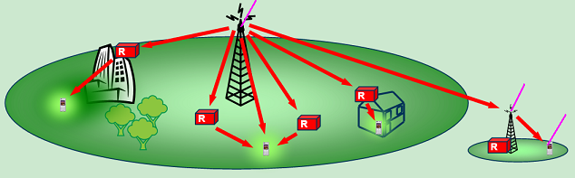
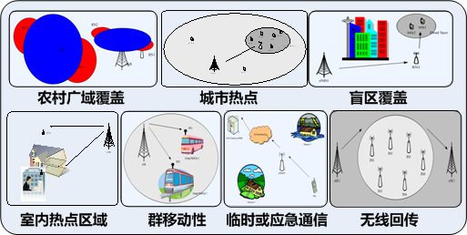
Relay
Backhaul Link
Concept
  Relay node is wirelessly connected
  to radio-access network via a donor cell
Benefit
  Relaying is considered for LTE-A
  to improve
    Cell-edge throughput
    Coverage extension
    Temporary network deployment
    Coverage of high data rates
Feature
  Type 1: in-band relay
  Type1a: out-of-band relay
  Type 1b: in-band relay full duplex
  Type 2: Repeater
Access Link
Rural area
Hot-spot
Blind area
Indoor hot-spot
Transportation
Emergency
Wireless backhaul

Slide 54
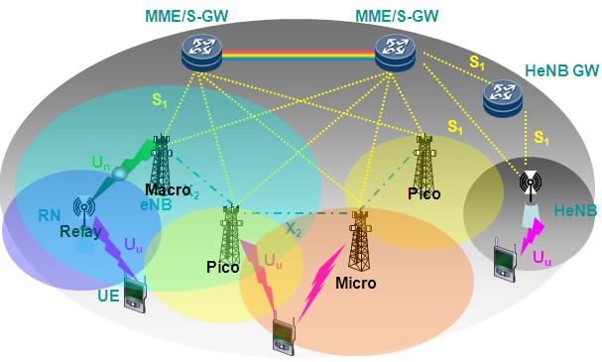
Enhanced ICIC
Concept
  Enhanced ICIC for non-CA based deployments of heterogeneous networks for LTE
    To reduce high inter-cell-interference (ICI) in coverage overlapped areas
Benefit
  Support highly variable traffic load
  Support increasingly complexity and
  network deployments with unbalanced
  transmit power nodes sharing same
  frequency
Feature
  Low power nodes include
    Remote radio head (RRH)
    Pico eNB
    Home eNB (HeNB)
    Relay nodes
  Time Domain based for DL control Info
  Time and Frequency shifting for reference signal within a cluster
  Scrambling code for reference signals between clusters.
High interference exists in coverage overlapped areas

Slide 55
Contents
1
Market Drivers and Background (30 min)
2
LTE Technology Overview (75 min)
3
LTE Advanced Overview (30 min)
4
LTE Deployment Landscape (15 min)
Notes:
55

Slide 56
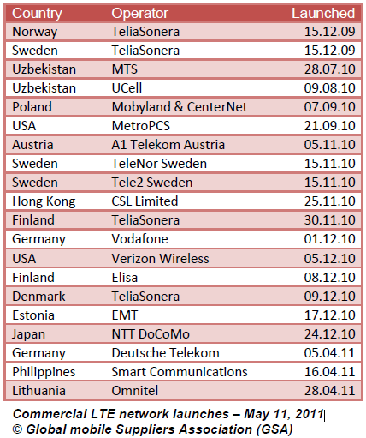
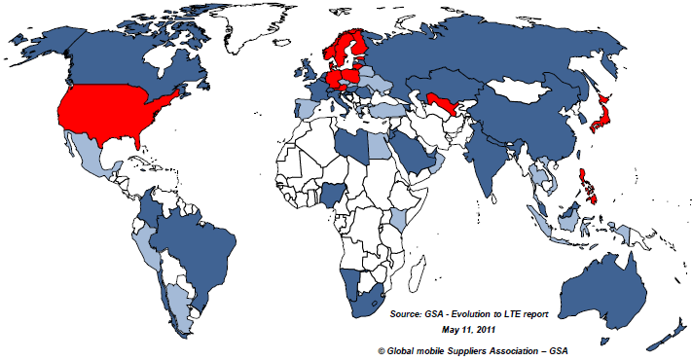

LTE Adoption Worldwide
208 operators in 80 countries investing in LTE
154 commercial LTE network commitments in 60 countries
54 pre--commitment trials in additional 20 countries
20 commercial LTE networks launched in 14 countries
20 commercial LTE networks in 14 countries
Countries with commercial LTE service
Countries with LTE commercial network deployments on-going or planned
Countries with LTE trial system

Slide 57



















LTE Global Landscape
Germany
Germany
Austria
Commercially Launched
Hong kong
Japan
(BAND 9)
Demark
Bahrain
Saudi Arabia
Germany
Germany
Latvia
Belgium
Singapore
Japan
Sweden
Norway
Serbia
Demark
Hungary
Finland
HongKong
USA
USA
Saudi Arabia
Uzbekistan Armenia
Germany
Hong kong
Australia
Norway Sweden
Finland Estonia
Demark
Austria
Germany
USA
USA
(L-BAND)
Canada
Russia
Sweden
Demark
Sweden
Hongkong
Sweden
Demark
Japan
Poland
Japan
Germany
USA
USA
Poland
2.6GHz
2.1GHz
1800MHz
1500MHz
DD800
DD700
AWS
TDD-2.5G/2.3G

Slide 58











LTE Ecosystem is Building
USB Dongle
MiFi / Router
Module / Notebook
Phone / Tablet
GT-B3710 / B3730
EM920
SCH-r900
Galaxy Tab
E589/E593
E398/E397/E392
MC7750/
MC7700
MC7710
US B-LTE 7110
4510L
Droid Bionic XT865
Xoom
032038-AL/ 121341-AL 041213-AL/ 40-AL
N150
ZLR-2070S
LD100/VL600/M13
T130
VS910 Resolution
RD-3
Mobile Hotspot
Pavilion dm1-3010nr
Thunderbolt
UML290
Mini CQ10-688NR
Chipset
Red: multi-mode
98 LTE devices are commercially available (GSA, Mar. 2011).
Spectrums focus from 2.6G, 700M, AWS extending to 1.8G, 800M, 2.1G
Smartphone, computer and consumer electronic devices will incorporate embedded LTE connectivity.

Slide 59
Thank You!

